Slide 1
RESPONSIBILITY
Teaching Character Series

Slide 2
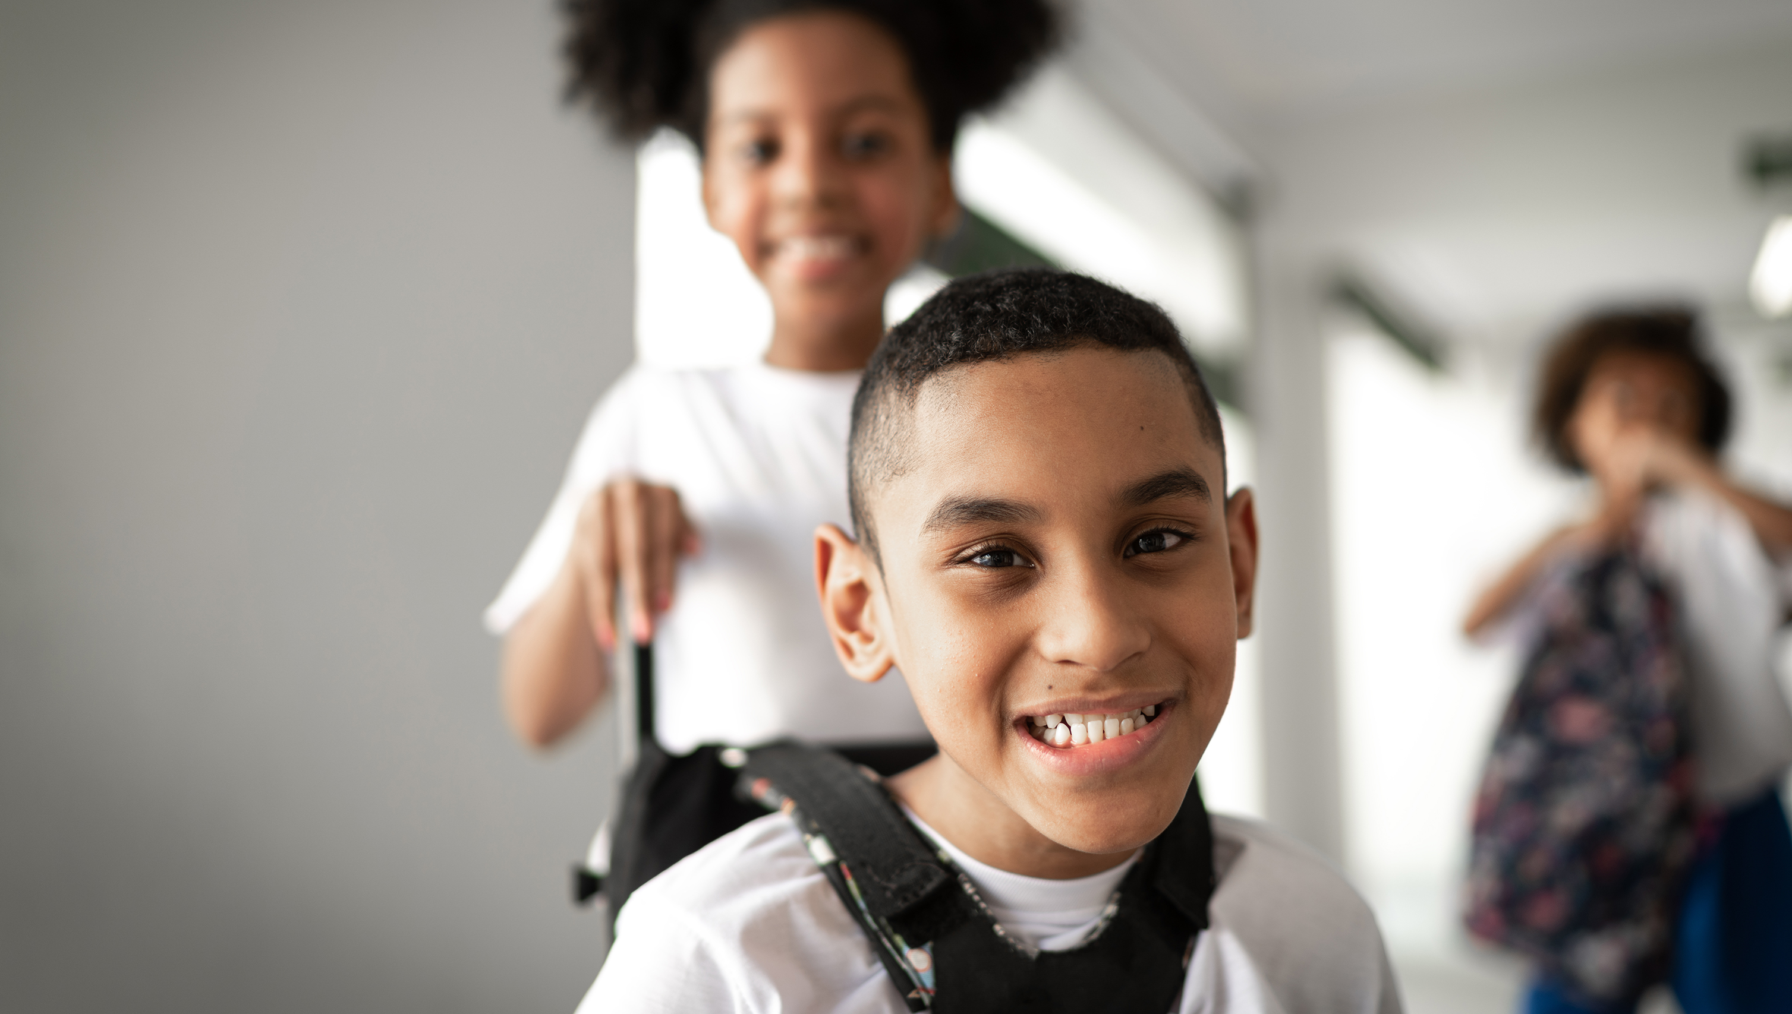
What does ‘responsibility’ or ‘being responsible’ mean?

Slide 3
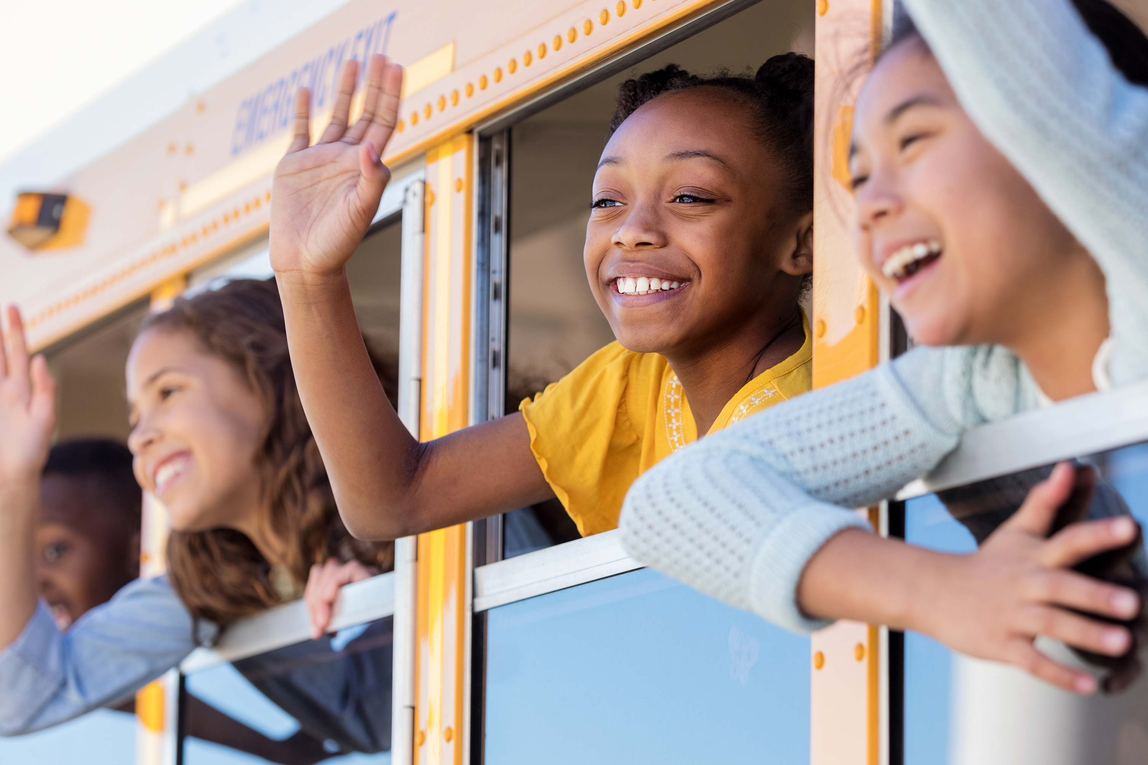
Responsibility means…
“being accountable (taking the credit or blame) for my decisions and actions and for the consequences of my decisions and actions.”

Slide 4
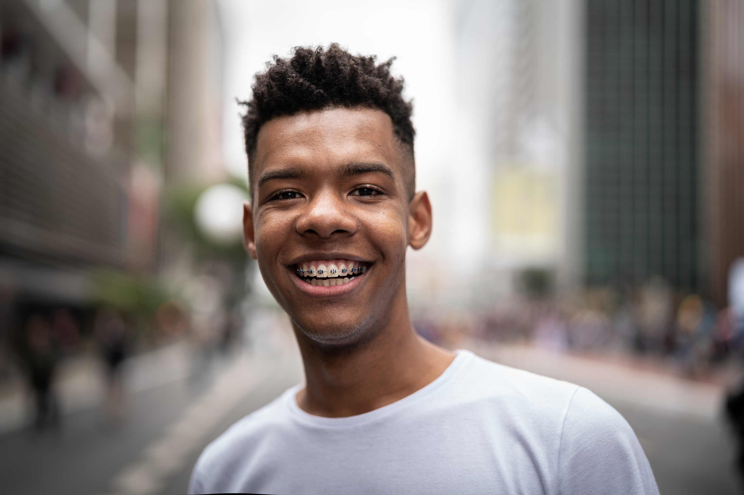
DISCUSS THIS QUOTE:
”Handle your business or
your business will handle you.”

Slide 5
RESPONSIBILITY QUIZ
I take good care of my own things.
I own up when I know I did something wrong.
I finish the tasks I start.
I take care of things that do not belong to me.
I do my assignments, homework and my share of group projects.
I get to school and my classes on time.

Slide 6
HOW DID YOU DO?
Less than 3 out of 7: You need to work on being more responsible.
3 or 4 out of 7: You are on your way, but there’s room for improvement.
5 out of 7: You are pretty responsible.
6 or 7 out of 7: Bravo! We applaud you for being a RESPONSIBLE PERSON!

Slide 7
POSITIVES & NEGATIVES
A responsibility is something you are expected to do
When you DO something you are responsible for
There is a POSITIVE result
Being responsible means
you do the things you are supposed to do
AND
you accept the results of your actions
When you DON’T do something you are responsible for
There is a NEGATIVE consequence

Slide 8
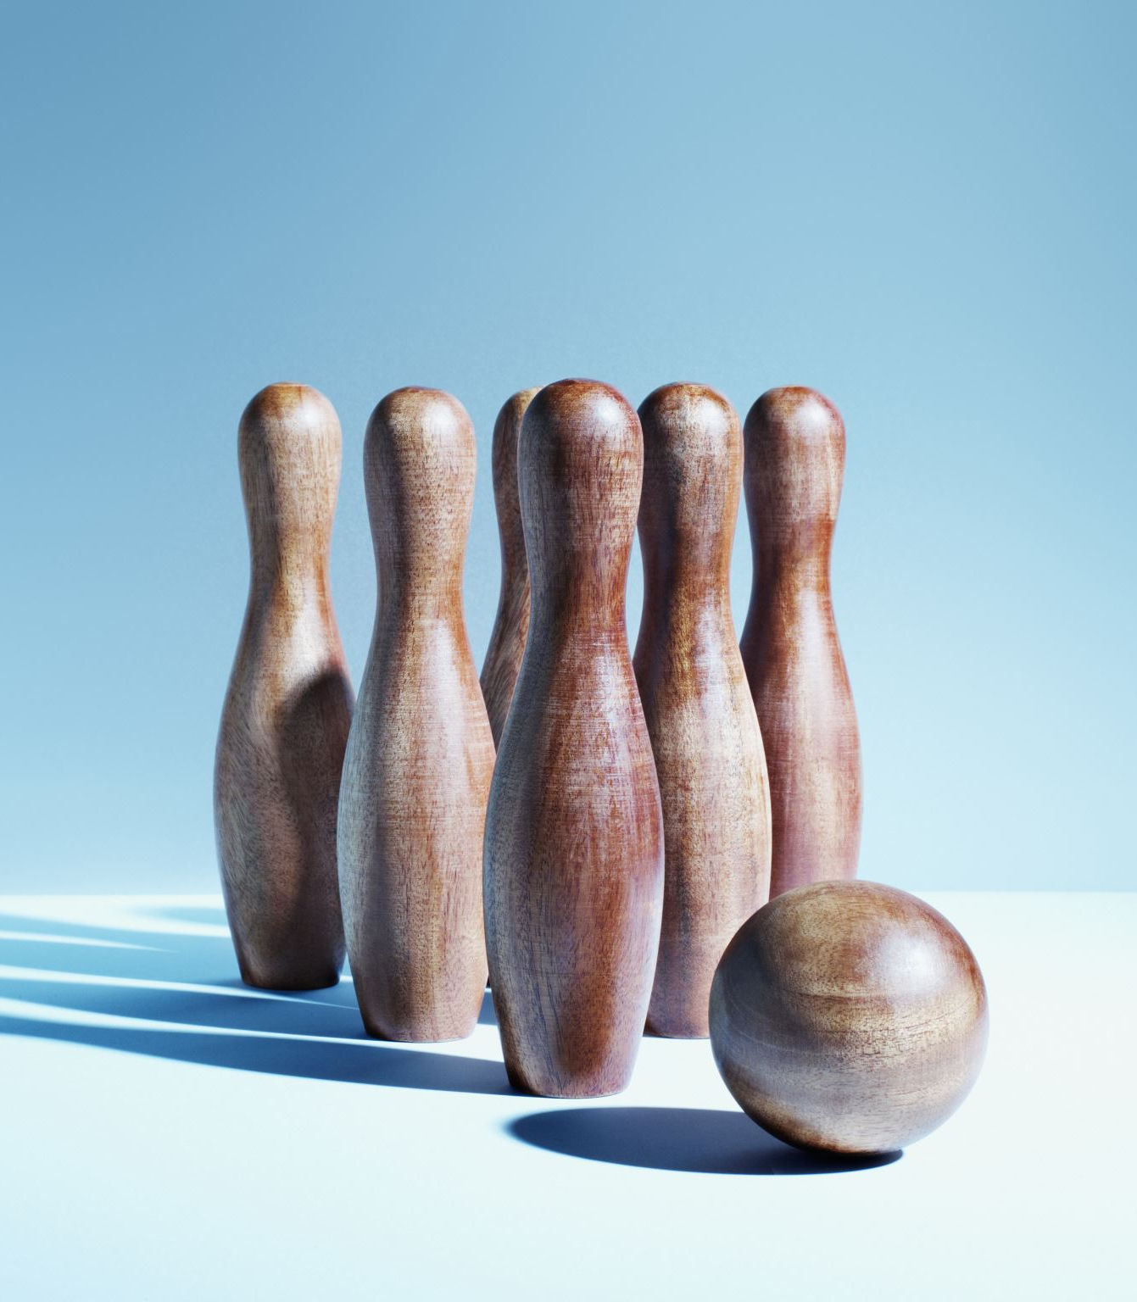
TAKING RESPONSIBILITY IS…
Not blaming others or making excuses
Owning up to our actions; admit to making mistakes
Owning how we choose to think or feel
Taking care of our health and personal hygiene
Owning our behavior, attitude and character
Being accountable

Slide 9
EXCUSES
Why do we make excuses?
Can you think of 3 excuses you have used recently?
Did they work?
Is it easier to make excuses or take responsibility? Why?

Slide 10
SIX AREAS WE ARE RESPONSIBLE
Moral Responsibility
Legal Responsibility
Family Responsibility
Community Responsibility
Responsibility To Our Customs, Traditions, Beliefs & Norms
Personal Responsibility

Slide 11
WHY IS BEING RESPONSIBLE IMPORTANT?
When you are responsible:
People can trust you to do what you say you’ll do
You get positive results and avoid negative consequences
Helps people live together safely and with cooperation

Slide 12
In Case You Haven’t Heard it Today,
Let Us Be the First to Say…
WE LOVE YOU!

