Slide 1
FINDING THE POWER IN YOUR VOICE
3 Things You Should Know

Slide 2
THE Sound of your voice

Slide 3
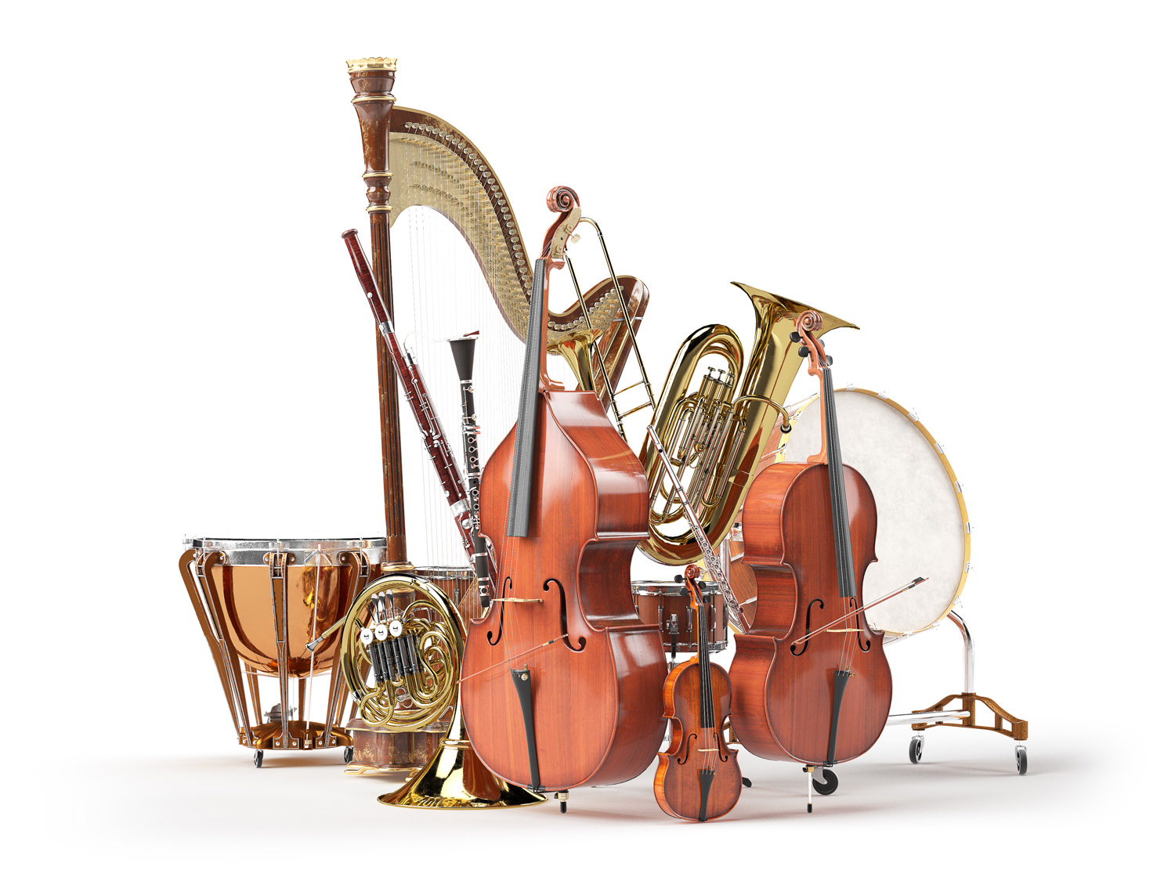
Your sound is needed
1. FILL THE AIR WITH VALUE

Slide 4
2. The Power to Use Your
Voice is NOT Easy

Slide 5
THINK, PAIR & SHARE
Describe a time when you felt voiceless or powerless. What led you to feel that way?
Describe a time when your voice was strong. What helped you to find the “power in your gut”?

Slide 6
3. UNMUTE YOURSELF &
REFUSE TO BE MUTED

Slide 7
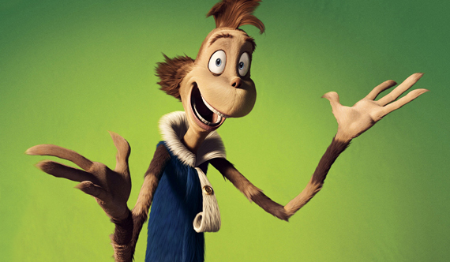
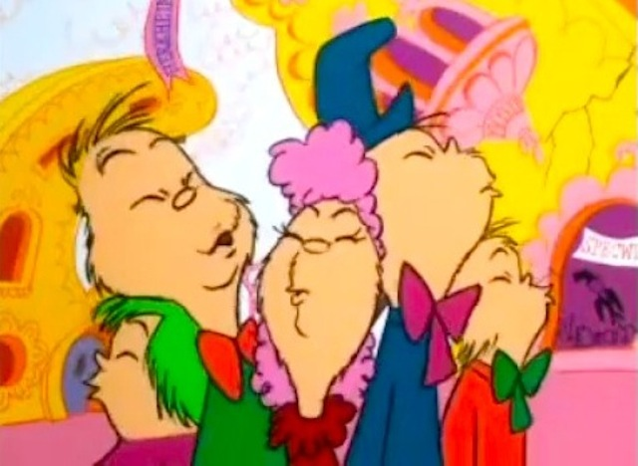
“The time for all Whos who have blood that is red,
To come to the aid of their country!”, he said.
“We’ve GOT to make noises in greater amounts!
So, open your mouth, lad! For every voice counts!”
Mayor of Whoville
Make your voices heard
Dr. Seuss, “Horton Hears a Who”

Slide 8
In Case You Haven’t Heard it Today,
Let Us Be the First to Say…
WE LOVE YOU!

Slide 9
THANK YOU!

